Slide 1
IT457 – Cloud Computing

Slide 2
Course Information
Grading Scheme
Mid-sem exam – 40%
End-sem exam – 40%
Labs – 20%
*subject to online exam system working well

Slide 3
Course Information
Course Plan
Cloud Computing – Developer perspective
Cloud Computing – Architect perspective
Cloud Computing – IT perspective
Cloud Service Providers
Azure
References
Online material (like here, here and here).
No single reference book

Slide 4

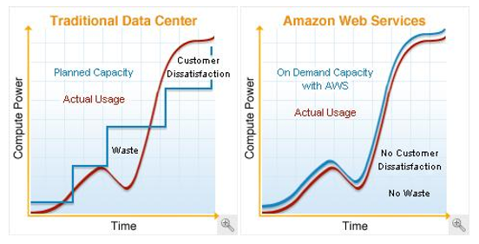
Cloud Computing
BUILDING BLOCKS
Definition
“Cloud computing is a specialized form of distributed computing that introduces utilization models for provisioning and measured resources
Business Drivers (i.e. motivation)
Capacity Planning
Cost Reduction
Organizational Agility
remotely
scalable
and platform services
”.
Organizational agility is the measure of an organisation’s responsiveness to change.
IT enterprise needs to respond to business change by scaling its IT resources beyond what was predicted or planned.
New business requirement for IT resources to be more available & reliable than before.
Budget constrains scales down up-front investments in IT and makes it vulnerable to such risks.
IT support of new and expanded business automations an ever-increasing investment
Two costs need to be accounted for:
Cost of acquiring new infrastructure
Operational / maintenance cost
Operational overhead represents for large share of IT budgets
Operation overheads – technical manpower, upgrades & patches, utility bills – power & cooling, security & access control, administrative & accounting (licensing etc.)
Lead Strategy – adding capacity to an IT resource in anticipation of demand.
Lag Strategy – adding capacity when the IT resource reaches full capacity
Match Strategy – adding IT resource capacity in small increments as demand increases.
Problems:
Accommodate Max Load – over expenditure
Moderating expenditure – transaction losses & usage limitations.
Notes:
Capacity planning – irctc tatkal booking overload. Add capacity by increasing servers – un/underutilized during non-peak hours.
Cost – acquiring new infra & ongoing / maintenance cost

Slide 5
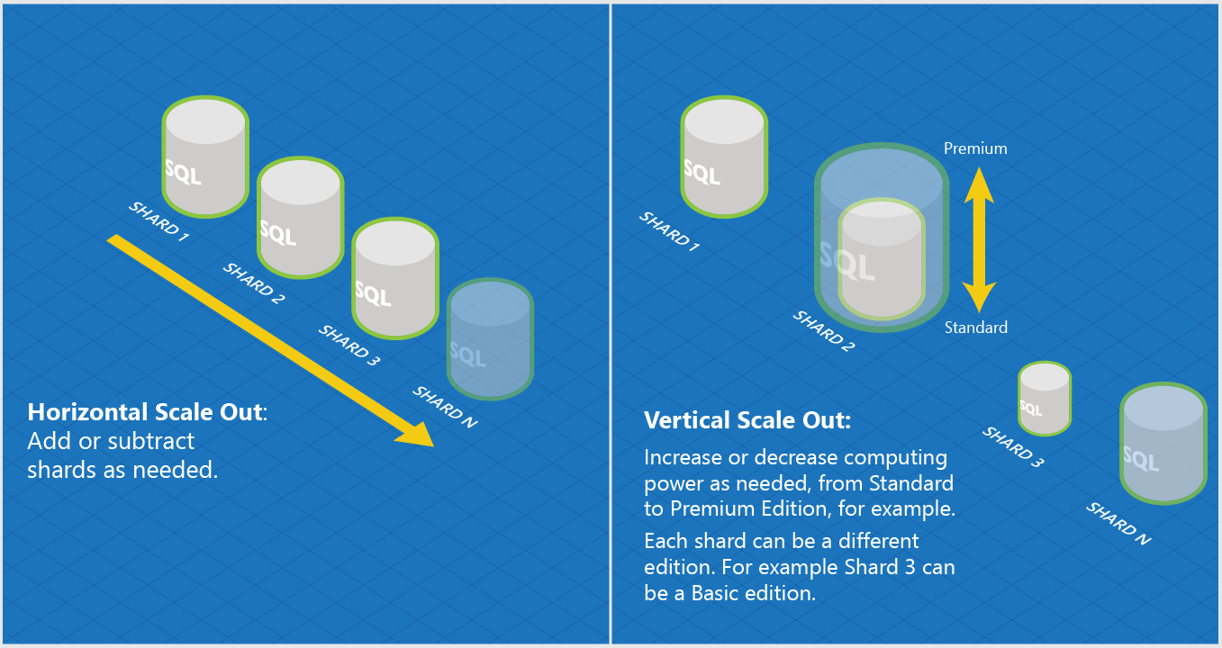
Basic Concepts & Terminologies
BUILDING BLOCKS
Cloud (same as internet?)
IT Resource
On-Premise
Cloud Consumers & Cloud Providers
Scaling
Vertical (Scale Up)
Horizontal (Scale Out)
Cloud Service
Cloud Service Consumer

Slide 6
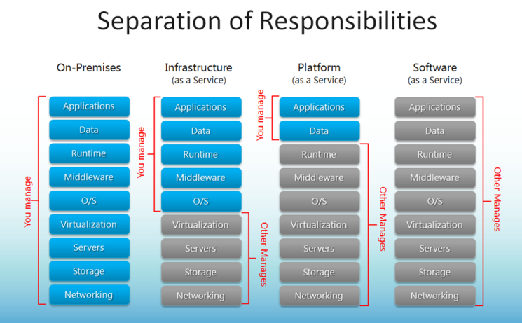
Cloud Delivery Models
BUILDING BLOCKS
IaaS – Infrastructure as a Service
PaaS – Platform as a Service
SaaS – Software as a Service
Combining Cloud Delivery Models
Notes:
Is website in old days a SaaS?

Slide 7
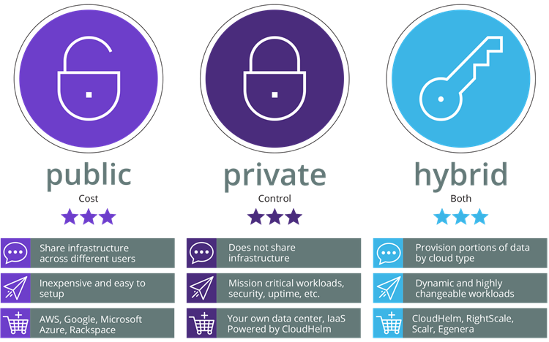
Cloud Deployment Models
BUILDING BLOCKS
Public Cloud
Private Cloud
Hybrid Cloud
Community Cloud

Slide 8
Cloud vs Traditional
Traditional (on-premises) Systems
Cloud based Systems
Monolithic, centralised
Design for predictable scalability
Relational database
Strong consistency
Serial and synchronised processing
Design to avoid failures (MTBF)
Occasional big updates
Manual management
Snowflake servers
Deconstructed, decentralised
Design for elastic scale
Polyglot persistence (mix of storage technologies)
Eventual consistency
Parallel and asynchronous processing
Design for failure (MTTR)
Frequent small updates
Automated self-management
Immutable infrastructure

Slide 9
Cloud Provider – AWS
BUILDING BLOCKS
Amazon Web Services
AWS World
AWS Organizations
AWS Account
AWS Account
OU: Admins
SCP: Admin
AWS Account
OU: Dev
AWS Account
AWS Account
AWS Account (Master)
SCP: DevTest
AWS Company Account
OU: Test
AWS Account
AWS Account
Notes:
SCP – Service Control Policy

Slide 10



AWS – IAM vs Organizations
BUILDING BLOCKS
IAM (Identity and Access Management)
Organizations
AWS Account
Root A/C
AWS Account
Test Policy
Dev Policy
Test SCP
Dev SCP
Billing & Usage
Test Team
Dev Team
Test OU
Dev OU
AWS A/C
AWS A/C
Organization
Groups
Prod OU
Prod Team
AWS A/C
Prod Policy
Prod SCP

Slide 11
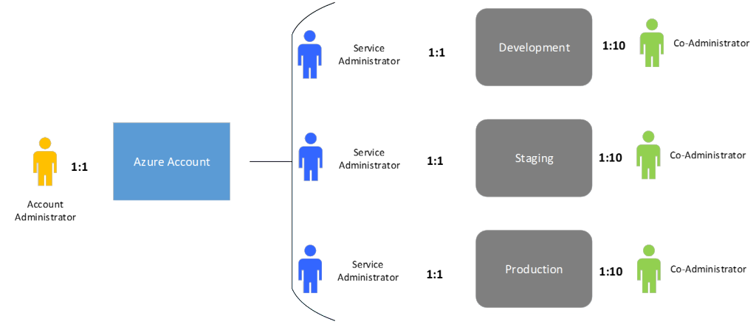
Cloud Provider – Azure
BUILDING BLOCKS
Azure World
<id>@Hotmail.com; <id>@outlook.com; <id>@live.com;
Used for accessing various Microsoft services.
Subscriptions
$
Microsoft Account
$
Organizational Account
$
<id>@<org name>.onmicrosoft.com => Gives a unique domain for accessing Azure services for the org.

Slide 12
Data Centres Technology - AWS
BUILDING BLOCKS
Global scope (eg. AWS Account)
Amazon Web Services
Region
Regional scope (eg. EC2 Instance ID)
Regions are completely isolated from other regions
Greatest possible fault tolerance & stability
Will not replicate resource across regions automatically
Charge for data transfer across regions
Availability Zone
Region
Zone scope (eg. EC2 Instance)
Availability Zone maps to one or more physical data centre (facility) of Amazon.
AZs are connected to each other with fast, private FO networking.
Distribute instances across AZs for continuity of application.
Availability Zone
Availability Zone
dc
dc
Availability Zone
Availability Zone
Notes:
1. Resources viewable only by region.
2. AZs have to be chosen, either by user or by AWS.
3. Distribute instances across multiple Azs, one fails – redirect to another. Design app such a way.
4. AZ 3 letter identifier us-east-1a. Location of us-east-1a may not be same for two accounts
5. Constrained Azs, removed Azs. Azs in two accounts could be different.

Slide 13
Data Centre Technology - Azure
BUILDING BLOCKS
Azure
Storage data is triplicated in region and it’s paired region
Availability set is created by user. SLA of 99.95% holds only if two or more VMs are put in an AvSet.
Fault Domains – up to 3 per AvSet.
Update Domains – up to 5 (20 via RM) per AvSet.
Azure Region
Azure Region
Location
Location (dc, hardware cluster)
> 480 Km
FD 0
FD 1
FD 2
VM1
VM2
VM3
Availability Set
VM4
VM5
VM6
Azure Region
(Paired)
Same Update Domain
VM7
VM8

Slide 14
Quiz time!
BUILDING BLOCKS
Q. The SQL database instance in cloud is throttling. I move it from Standard tier to Premium tier. This move is an example of Horizontal or Vertical scaling?
A. Vertical scaling.
Q. I need to create my resume for placement interviews. I run MS Word online through Office 365 subscription to create my resume. This is an example of IaaS/PaaS/SaaS?
A. SaaS.
Q. I provisioned (created) an VM instance in my AWS cloud for installing a web server. This is an example of IaaS/PaaS/SaaS?
A. IaaS
Q. My company has multiple AWS accounts for running its business in AWS cloud. So many accounts are causing access and tracking confusions. My boss just asked me to look for a solution in AWS. What is that solution?
A. Use AWS organizations to create OUs & assign SCPs and make one AWS account as master account for that organization. The billing then will happen against that master AWS account.
Q. In Azure, an Azure subscription can have multiple Azure accounts. True or false?
A. False. An Azure account can have multiple subscriptions but not vice versa.
Q. In Azure, I create my Azure account and then created a VM under it. All good. True or False?
A. False. Without first creating a subscription, no resources can be created under an Azure account.

Slide 15
Exercise
For a web application, following are the resources that you are creating in Azure: Two servers, S1 & S2, for serving HTTP requests, two data base servers Db1 and Db2 for the databases and B1 & B2 servers for
processing back-end/business jobs for the service. How will you distribute these machines in availability sets, fault and upgrade domains to make a system resilience to failure?

Slide 16
Resource Management in Azure
Azure Resource Manager is the deployment and management service for Azure.
It provides a management layer that enables you to create, update, and delete resources in your Azure account.
You use management features, like access control, locks, and tags, to secure and organize your resources after deployment.

Slide 17
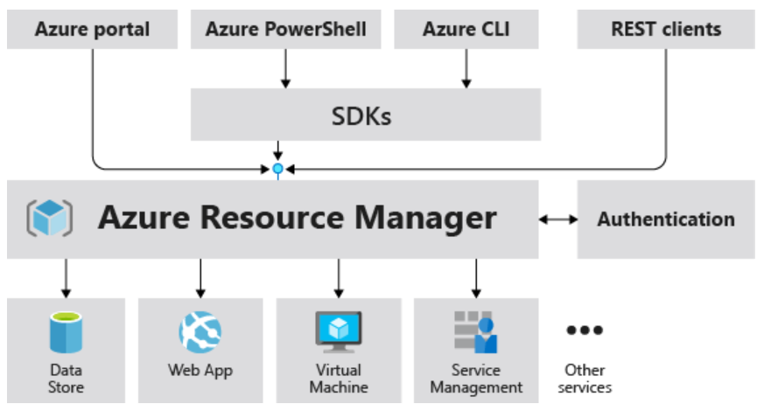
Consistent management layer
When a user sends a request from any of the Azure tools, APIs, or SDKs, Resource Manager receives the request.
When a user sends a request from any of the Azure tools, APIs, or SDKs, Resource Manager receives the request.

Slide 18
Terminology
resource - A manageable item that is available through Azure. Virtual machines, storage accounts, web apps, databases, and virtual networks are examples of resources. Resource groups, subscriptions, management groups, and tags are also examples of resources.
resource group - A container that holds related resources for an Azure solution. The resource group includes those resources that you want to manage as a group.
resource provider - A service that supplies Azure resources. For example, a common resource provider is Microsoft.Compute, which supplies the virtual machine resource. Microsoft.Storage is another common resource provider.
Resource Manager template - A JavaScript Object Notation (JSON) file that defines one or more resources to deploy to a resource group, subscription, management group, or tenant. The template can be used to deploy the resources consistently and repeatedly.

Slide 19
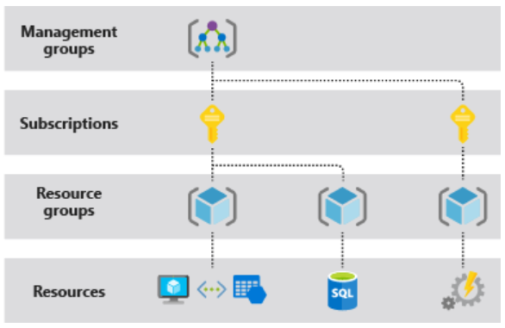
Understand scope
Azure provides four levels of scope: management groups, subscriptions, resource groups, and resources.
You apply management settings at any of these levels of scope
Lower levels inherit settings from higher levels.

Slide 20
Resource groups
All the resources in your resource group should share the same lifecycle. You deploy, update, and delete them together. If one resource, such as a server, needs to exist on a different deployment cycle it should be in another resource group.
Each resource can exist in only one resource group.
The resources in a resource group can be located in different regions than the resource group.
When creating a resource group, you need to provide a location for that resource group.
A resource group can be used to scope access control for administrative actions.
A resource can connect to resources in other resource groups. This scenario is common when the two resources are related but don't share the same lifecycle. For example, you can have a web app that connects to a database in a different resource group.
When you delete a resource group, all resources in the resource group are also deleted.
Some resources can exist outside of a resource group. These resources are deployed to the subscription, management group, or tenant. Only specific resource types are supported at these scopes.

Slide 21
AZURE AUTOMATION USING AZ CLI

Slide 22
az cli
The CLI is a tool designed to get you working quickly and efficiently with Azure services, with an emphasis on automation
Works on Windows, Mac OS, Linux
Can also be run in Azure portal as cloud shell
Sign In
az login

Slide 23
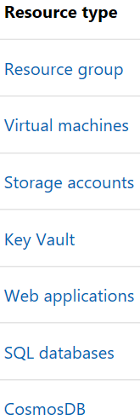
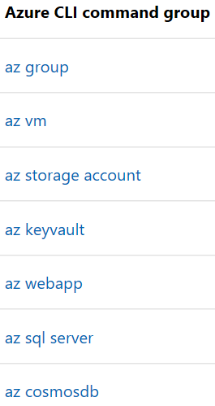
Common Commands
Commands in the CLI are organized as commands of groups.
Each group represents an Azure service, and commands operate on that service.

Slide 24
Globally available arguments
--help prints CLI reference information about commands and their arguments and lists available subgroups and commands.
--output changes the output format. The available output formats are json, jsonc (colorized JSON), tsv (Tab-Separated Values), table (human-readable ASCII tables), and yaml. By default the CLI outputs json. To learn more about the available output formats, see Output formats for Azure CLI.
--query uses the JMESPath query language to filter the output returned from Azure services. To learn more about queries, see Query command results with Azure CLI and the JMESPath tutorial.
--verbose prints information about resources created in Azure during an operation, and other useful information.
--debug prints even more information about CLI operations, used for debugging purposes. If you find a bug, provide output generated with the --debug flag on when submitting a bug report.

Slide 25
Creating a virtual machine using az cli
az login
In Azure, all resources are allocated in a resource management group.
Resource groups provide logical groupings of resources that make them easier to work with as a collection.
Create a resource group
az group create –name mscitrg –location centralindia
Create a vm under resource group
az vm create --resource-group mscitrg --name testvm1 --image ubuntults --admin-user lavneetsingh --generate-ssh-keys --verbose --output json

Slide 26
az vm show --name testvm1 --resource-group mscitrg
az group delete --name mscitrg --no-wait
az group wait --name mscitrg --deleted

Slide 27
Infrastructure as Code
With the move to the cloud, many teams have adopted agile development methods. These teams iterate quickly
They need to repeatedly deploy their solutions to the cloud, and know their infrastructure is in a reliable state
As infrastructure has become part of the iterative process, the division between operations and development has disappeared
Teams need to manage infrastructure and application code through a unified process (DevOps)

Slide 28
To meet these challenges, you can automate deployments and use the practice of infrastructure as code.
In code, you define the infrastructure that needs to be deployed. The infrastructure code becomes part of your project.
Just like application code, you store the infrastructure code in a source repository and version it.
Any one on your team can run the code and deploy similar environments.

Slide 29
ARM Templates – Infrastructure as Code in Azure
The template is a JavaScript Object Notation (JSON) file that defines the infrastructure and configuration for your project.
In the template, you specify the resources to deploy and the properties for those resources.
Hello World template:
{
"$schema": "https://schema.management.azure.com/schemas/2019-04-01/deploymentTemplate.json#",
"contentVersion": "1.0.0.0",
"resources": []
}

Slide 30
Template files
Within your template, you can write template expressions that extend the capabilities of JSON. These expressions make use of the functions provided by Resource Manager.
The template has the following sections:
Parameters - Provide values during deployment that allow the same template to be used with different environments.
Variables - Define values that are reused in your templates. They can be constructed from parameter values.
User-defined functions - Create customized functions that simplify your template.
Resources - Specify the resources to deploy.
Outputs - Return values from the deployed resources.
Notes:
https://docs.microsoft.com/en-us/azure/azure-resource-manager/templates/template-tutorial-create-first-template?tabs=azure-powershell

Slide 31
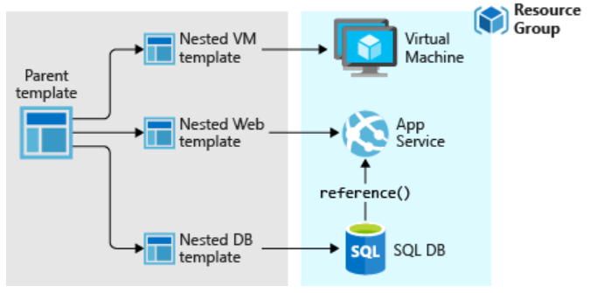
Template Design
You don't have to define your entire infrastructure in a single template.
Often, it makes sense to divide your deployment requirements into a set of targeted, purpose-specific templates
To deploy a particular solution, you create a master template that links all the required templates.

Slide 32
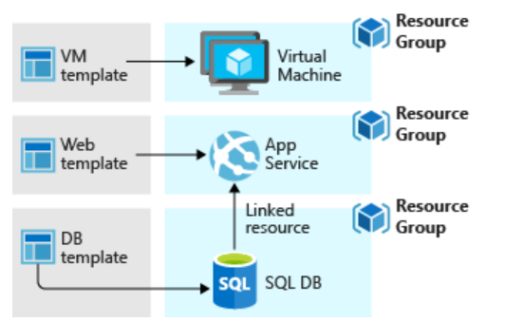
If you envision your tiers having separate lifecycles, you can deploy your three tiers to separate resource groups.
The resources can still be linked to resources in other resource groups

Slide 33
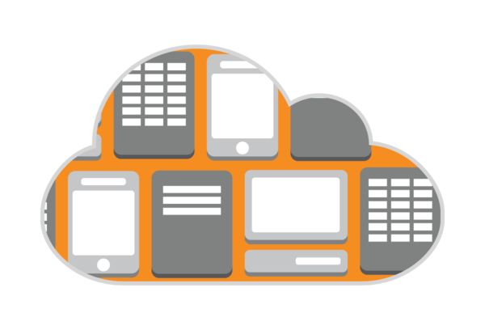
Cloud Architectures

Slide 34
N-Tier
Traditional layered
Higher layer calls lower ones, not vice-versa
Web-Queue-Worker
Purely PaaS
Microservices
Many small independent services
Event-driven Architecture
Can be a liability – not easy to update individual components
Suitable for app migration
Generally IaaS
Web FE + Worker BE
FE <-> BE communication through async msg Q
Suitable for simple domains
Services are loosely coupled
Communicate through API contracts
Uses pub-sub model
Pubs & Subs are independent
Suitable for apps that ingest large volume of data
Suitable when subsystems need to perform different actions on same data
Big Data Big Compute
Specialized architecture that fit certain profiles
Divides large datasets into chunks, parallel process and analysis

Slide 35
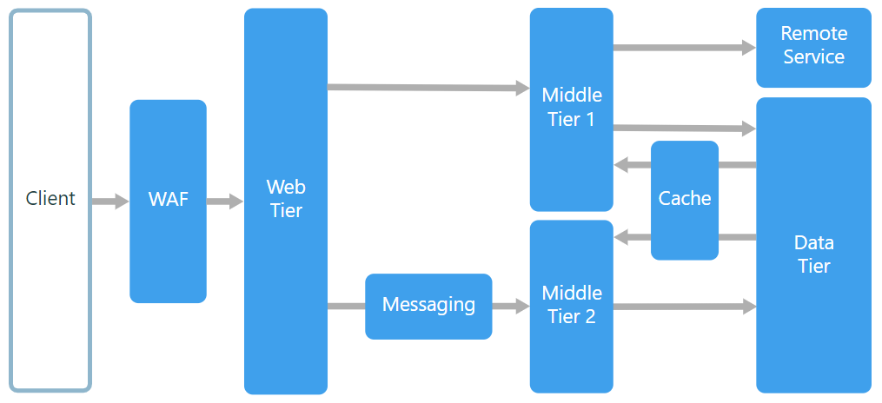
N-tier Architecture Style
An N-tier architecture divides an application into logical layers and physical tiers.
Layers are a way to separate responsibilities and manage dependencies.
Tiers are physically separated, running on separate machines.

Slide 36
When to use this architecture
Typically implemented as infrastructure-as-service (IaaS) applications, with each tier running on a separate set of VMs.
Consider an N-tier architecture for:
Simple web applications.
Migrating an on-premises application to Azure with minimal refactoring.
Unified development of on-premises and cloud applications.
Best practices
Use autoscaling to handle changes in load. See Autoscaling best practices.
Use asynchronous messaging to decouple tiers.
Cache semi static data. See Caching best practices.
Configure the database tier for high availability, using a solution such as SQL Server Always On availability groups.
Place a web application firewall (WAF) between the front end and the Internet.
Place each tier in its own subnet, and use subnets as a security boundary.
Restrict access to the data tier, by allowing requests only from the middle tier(s).

Slide 37
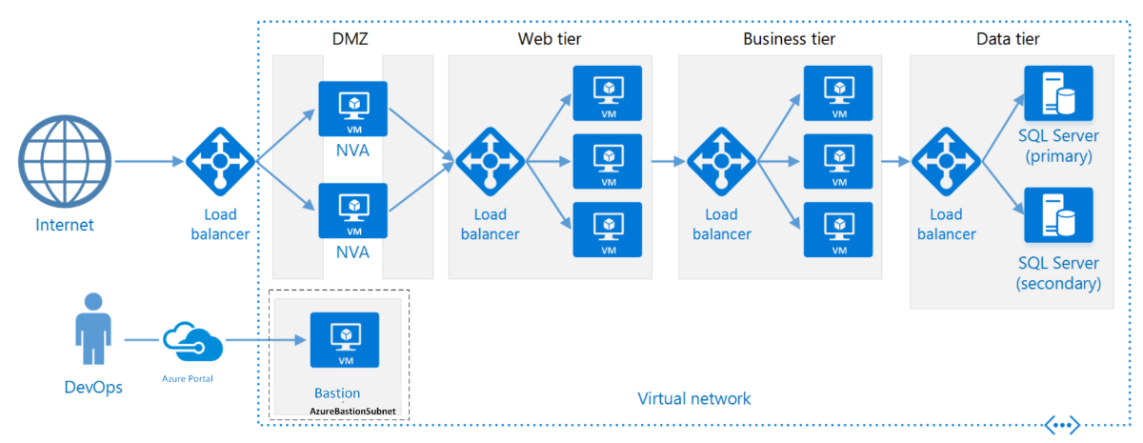
N-tier architecture on Virtual Machines

Slide 38
Each tier consists of two or more VMs, placed in an availability set or virtual machine scale set.
Multiple VMs provide resiliency in case one VM fails.
Load balancers are used to distribute requests across the VMs in a tier.
A tier can be scaled horizontally by adding more VMs to the pool.
Each tier is also placed inside its own subnet, meaning their internal IP addresses fall within the same address range.
That makes it easy to apply network security group rules and route tables to individual tiers.
The web and business tiers are stateless. Any VM can handle any request for that tier. The data tier should consist of a replicated database.
Network security groups restrict access to each tier. For example, the database tier only allows access from the business tier.

Slide 39
Role of Application Gateway
Web traffic load balancer enables us to manage traffic to our web applications
Operates at application level (OSI level 7 - Application).
Traditional load balancers operate at transport layer (OSI level 4 – TCP & UDP) and route traffic based on IP address and port.
Application Gateway can route traffic based on URL
SSL termination
supports terminate encryption at gateway, so data travels un-encrypted to the backend servers. Saves overhead.
Web application firewall – protection against common exploits
Multiple site hosting, Redirection, Session affinity etc.

Slide 40
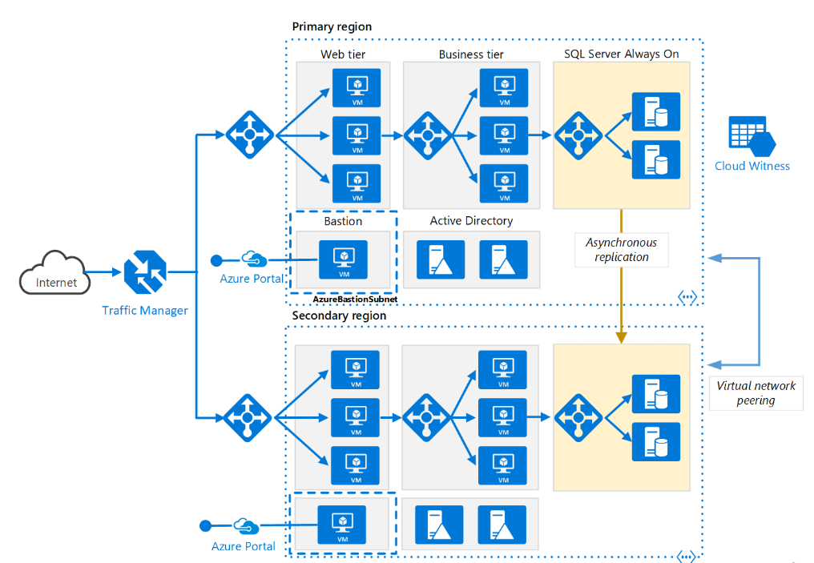
N-tier architecture – Multi-region deployment

Slide 41
Role of Traffic Manager in Multi-region deployment
Traffic Manager allows users to control traffic distribution across various application endpoints.
The Traffic Manager distributes the traffic using the configured routing method
Priority, Weighted, Performance, Geographic
Constant monitoring of the endpoint health.
Automatic failover in case the endpoints fail.
Functions at the DNS level. It uses the DNS to route clients to precise service endpoints, according to the traffic-routing rules and methods.
Traffic Manager operation modes:
Active | Passive – hot failover
Active | Passive – cold failover
Active | Active – load balanced

Slide 42
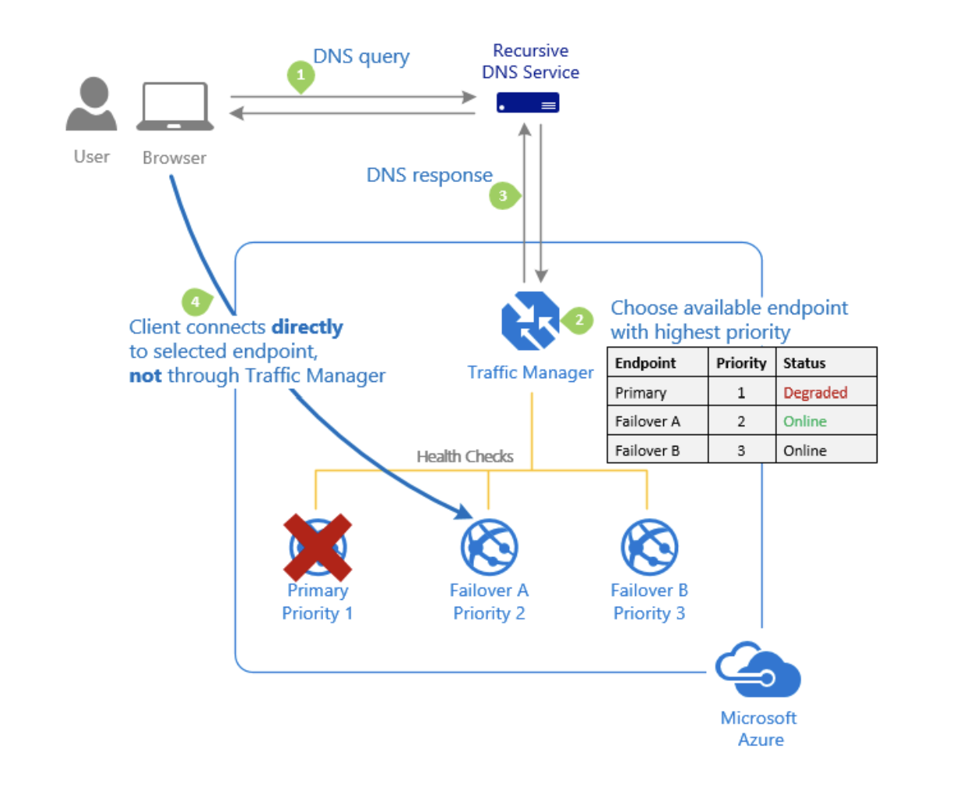
TM Routing - Priority
The 'Priority' traffic-routing method allows Azure customers to easily implement the failover pattern
By default, Traffic Manager sends all traffic to the primary (highest-priority) endpoint.
If the primary endpoint isn't available, Traffic Manager routes the traffic to the second endpoint.

Slide 43
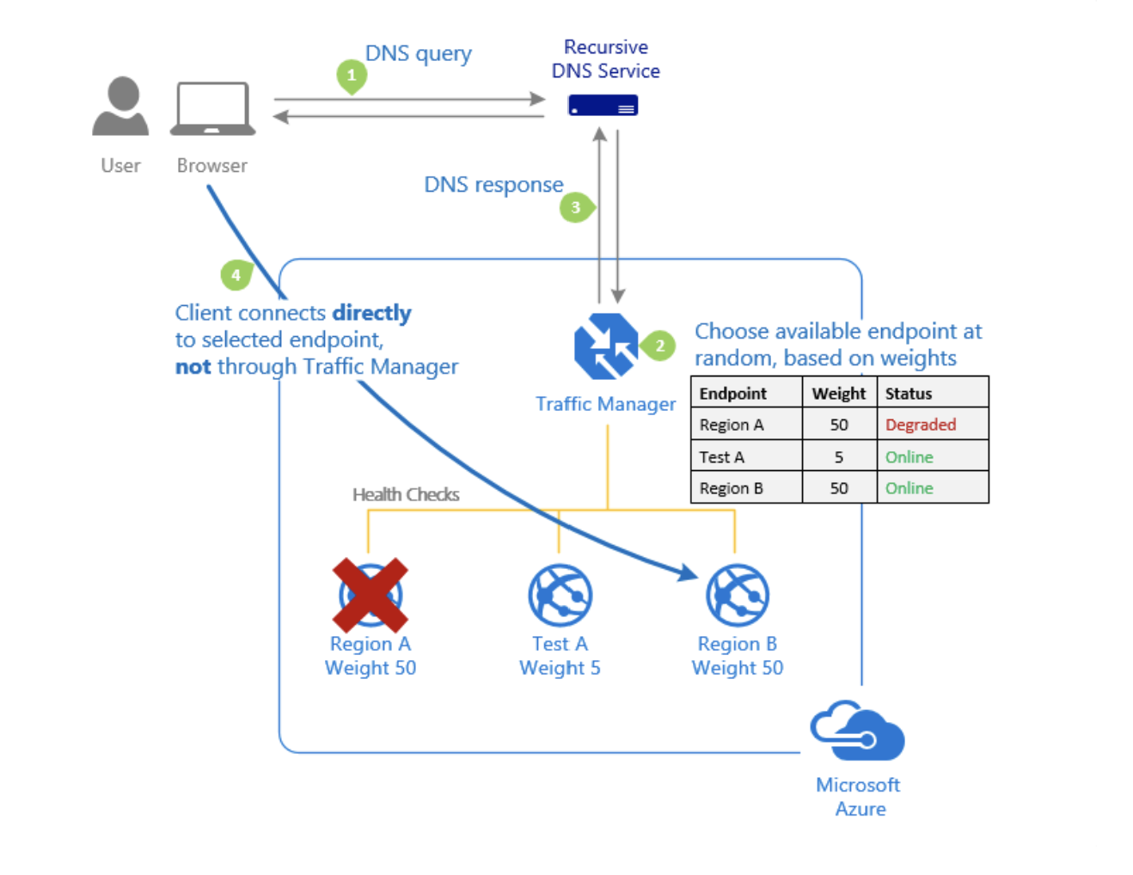
TM Routing - Weighted
Assign a weight to each endpoint in the Traffic Manager profile configuration. The weight is an integer from 1 to 1000.
For each DNS query received, Traffic Manager randomly chooses an available endpoint. The probability of choosing an endpoint is based on the weights assigned to all available endpoints.
Useful for
Gradual application upgrade
Application migration to Azure
Cloud bursting for more capacity

Slide 44
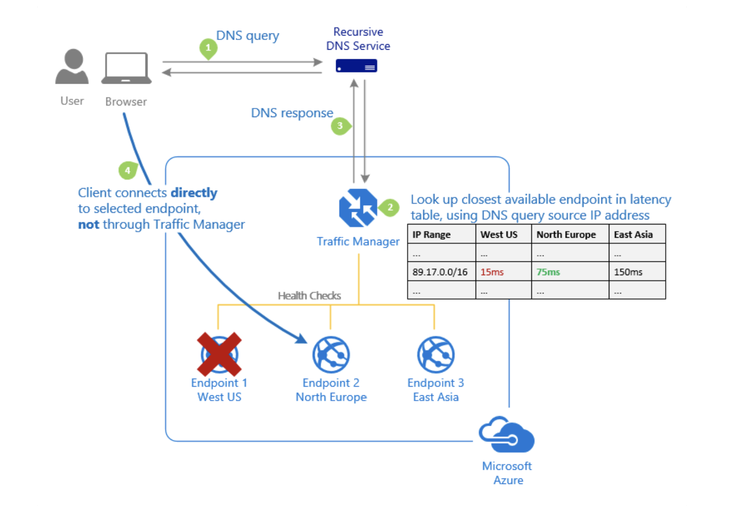
TM Routing - Performance
Traffic Manager maintains an Internet Latency Table to track the round-trip time between IP address ranges and each Azure datacenter.
'Performance' traffic-routing method determines the closest endpoint by measuring network latency.
Traffic Manager looks up the source IP address of the incoming DNS request in the Internet Latency Table. Traffic Manager then chooses an available endpoint in the Azure datacenter that has the lowest latency for that IP address range. Then Traffic Manager returns that endpoint in the DNS response.

Slide 45
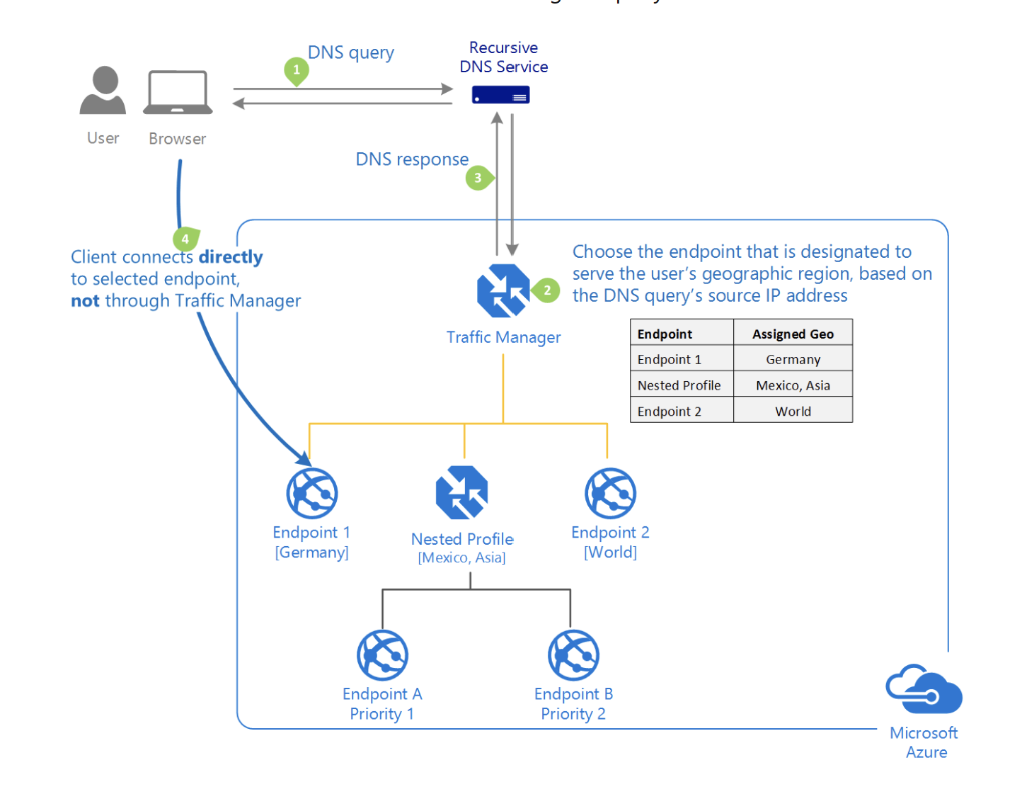
TM Routing - Geographic
Users get directed to specific endpoints: Azure, External, or Nested. Matching is based on the geographic location that the DNS query originates from.
With this routing method, it enables you to be in compliance with data sovereignty mandates, localization of content & user experience and measuring traffic from different regions.

Slide 46
TM Routing – Geographic …contd.
A geographic region can be at following levels of granularity
World, Regional grouping (e.g. Africa, Middle-east, Europe, Asia-pacific), Country/Region (India, Peru, Hong-kong), State/Province (USA-California, Australia-Qeensland)
TM Look-up starts from more specific to more general
If a user’s region is listed under two different endpoints’ geographic mapping, Traffic Manager selects the endpoint with the lowest granularity.
If a query is coming from a geographic region that has no mapping in that profile, Traffic Manager returns a NODATA response.

Slide 47
TM Routing – Nested Profiles
Each Traffic Manager profile specifies a single traffic-routing method, sometimes not sufficient
Nest Traffic Manager profiles to combine the benefits of more than one traffic-routing method
To create a nested profile, you add a 'child' profile as an endpoint to a 'parent' profile.
MinChildEndpoints
This parameter with a default value of 1 is created when you create a child profile.
Determines the minimum number of endpoints that must be available in the child profile for it to be healthy
Below this threshold, the parent profile will consider the entire child profile as unavailable, and direct traffic to the other parent profile endpoints.

Slide 48
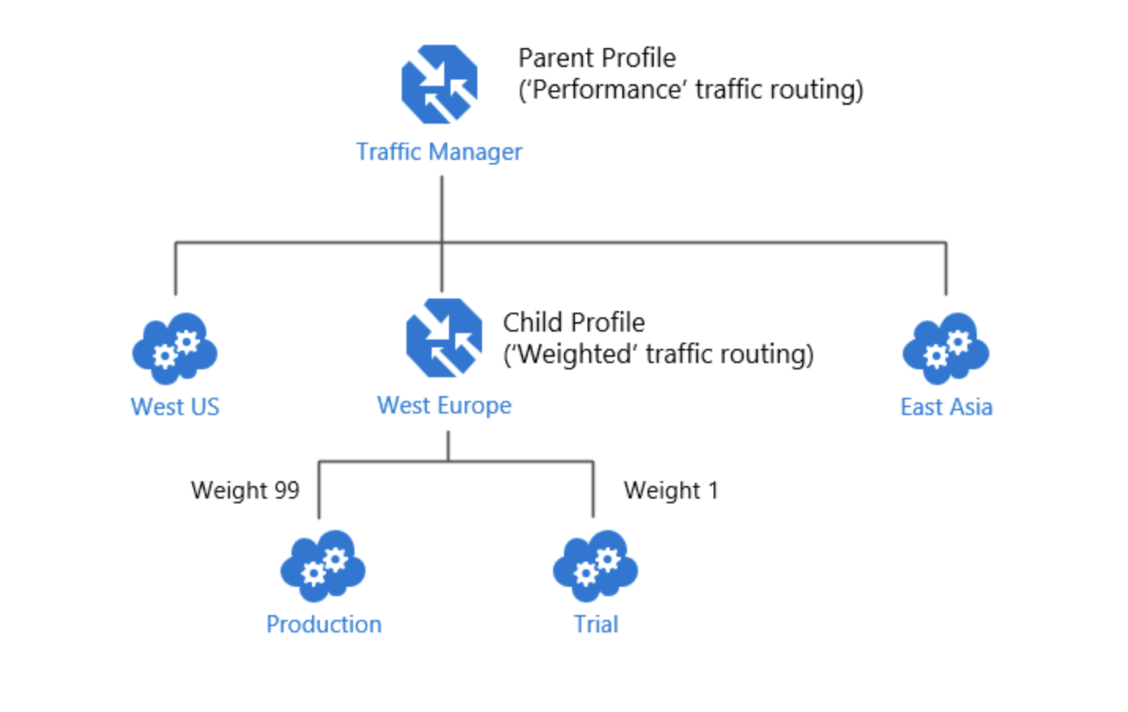
Example Nested Profiles – Combining Performance & Weighted Routing
deployed an application in the following Azure regions: West US, West Europe, and East Asia in Perf profile
Test and update before wide deployment – deployed only in WE region.
Only small traffic should come to the test update in WE
Can’t use perf. Create Child profile with Weighted routing

Slide 49
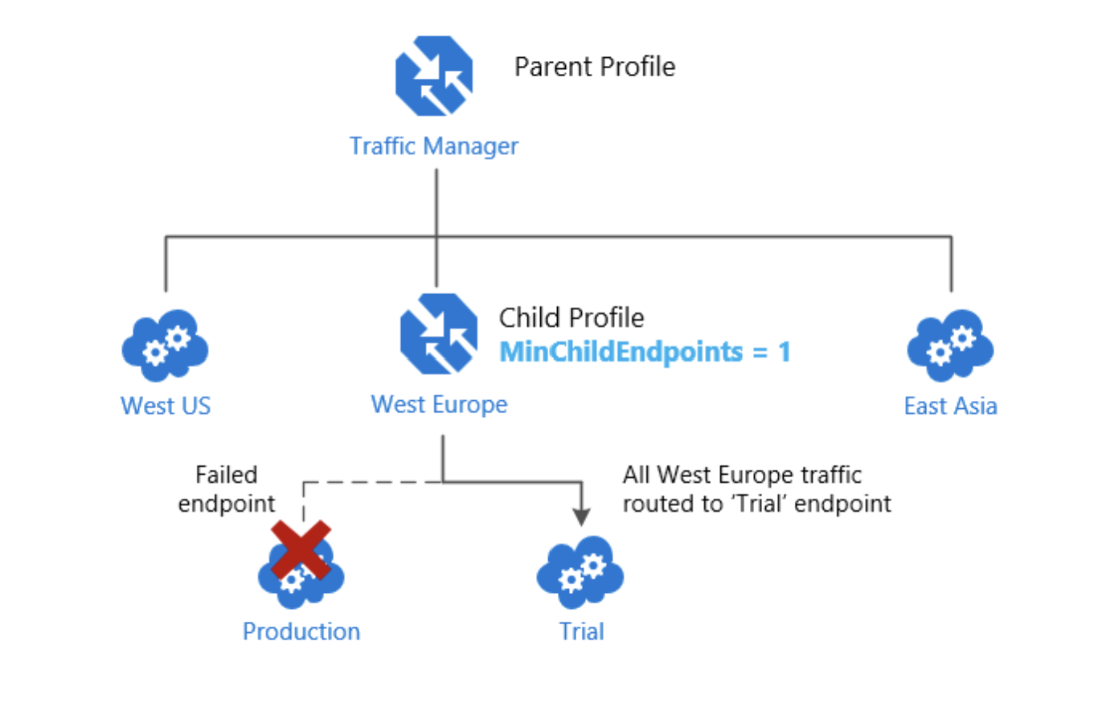
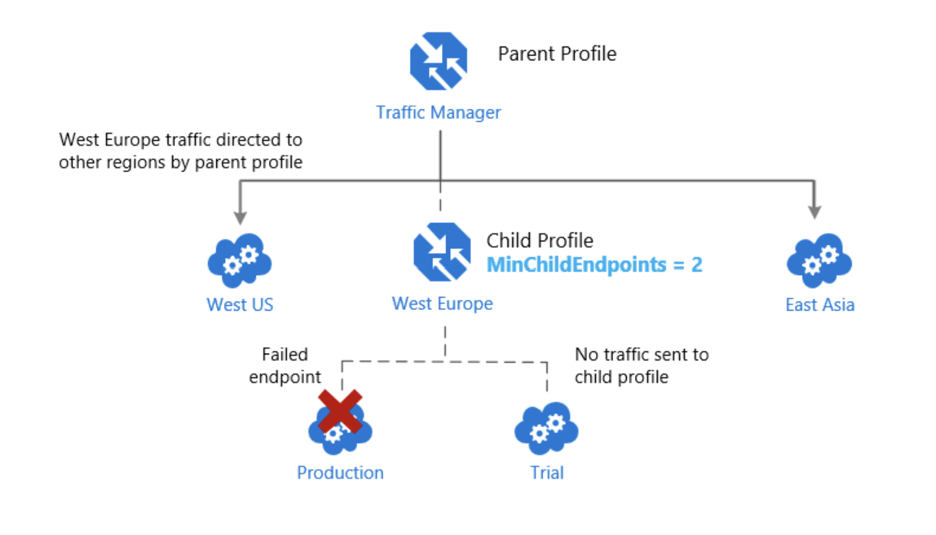
Nested Profiles – Endpoint monitoring
Is it okay to route all traffic to the trial deployment? If not, change the profile parameter value to 2
The parent profile will consider whole WE down because it needs minimum of 2 endpoints to consider it up and running.

Slide 50
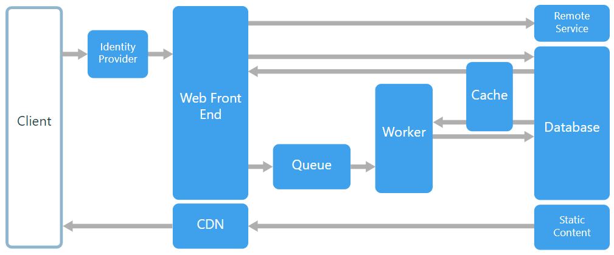
Web-Queue-Worker architecture

Slide 51
The core components of this architecture are
a web front end that serves client requests,
a worker that performs resource-intensive tasks, long-running workflows, or batch jobs.
a message queue - the web front end communicates with the worker through it.
Other components that are commonly incorporated into this architecture include:
One or more databases.
A cache to store values from the database for quick reads.
CDN to serve static content
Remote services, such as email or SMS service. Often these are provided by third parties.
Identity provider for authentication.

Slide 52
The web and worker are both stateless.
Session state can be stored in a distributed cache.
Any long-running work is done asynchronously by the worker.
The worker can be triggered by messages on the queue or run on a schedule for batch processing.
The worker is an optional component. If there are no long-running operations, the worker can be omitted.
The front end might consist of a web API.
On the client side, the web API can be consumed by a single-page application that makes AJAX calls, or by a native client application.

Slide 53
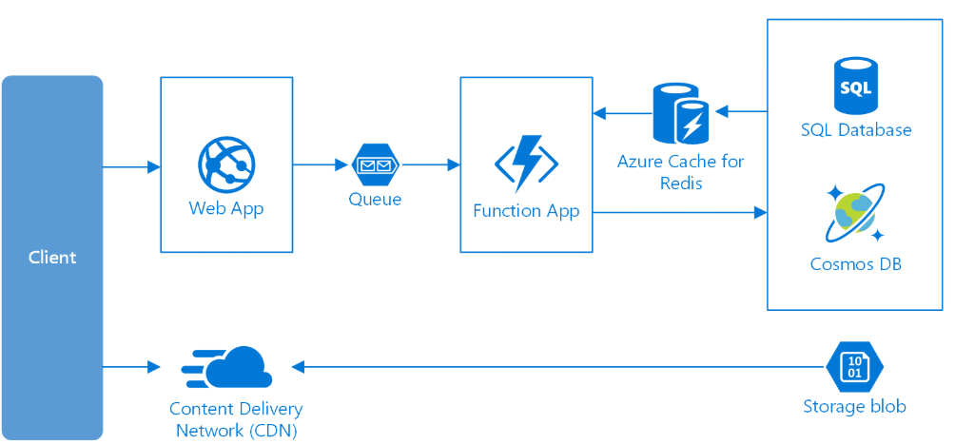
Web-Queue-Worker on Azure

Slide 54
Consider this architecture style for:
Applications with a relatively simple domain.
Applications with some long-running workflows or batch operations.
When you want to use managed services, rather than infrastructure as a service (IaaS).

Slide 55
Cloud Storage

Slide 56
Scenario: Disks & File system in cloud for VMs
VMs in cloud need disk drive for
Operating System
Temporary Data
Data storage
Applications running on VMs may also want to access files in a file system just like they do while running on actual h/w machine. Important for
cloud migration
shared file stores
developer tools etc.

Slide 57
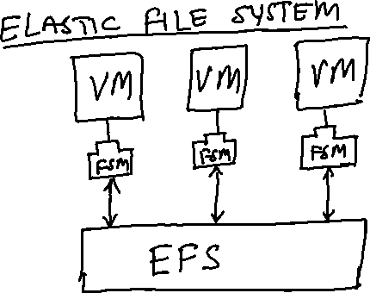

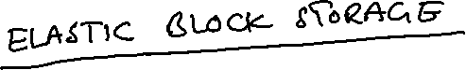
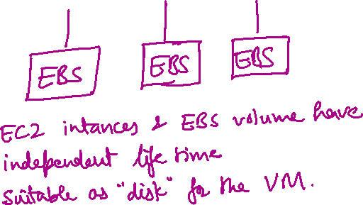
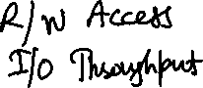
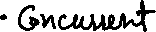
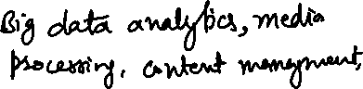
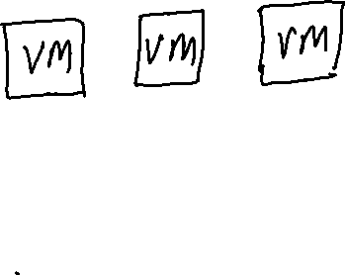

AWS Solution: EFS & EBS

Slide 58
Azure Solution: Azure Disks & Azure Files
Azure Files offers fully managed file shares in the cloud that are accessible via the Server Message Block (SMB) protocol.
ideal replacement for file shares on-premises
Azure file shares can be mounted concurrently by cloud or on-premises deployments of Windows, Linux, and macOS.
share a file system across multiple machines, applications/instances.
Azure file shares can be cached on Windows Servers with Azure File Sync for fast access near where the data is being used.
Azure Disks: OS disk, Temporary disk, Data disk. Unmanaged and Managed disks. Always use managed disks
Notes:
Unmanaged disks are the traditional type of disks that have been used by VMs.
Managed Disks handles the storage account creation/management in the background for you, and ensures that you do not have to worry about the scalability limits of the storage account. You simply specify the disk size and the performance tier (Standard/Premium), and Azure creates and manages the disk for you.

Slide 59
Scenario: Serving Static web content and media
Static web content typically include HTML pages and other resources like images, video and documents – scripts, pdf downloads etc.
Although web servers are well tuned to optimize requests through efficient dynamic page code execution and output caching, they still have to handle requests to download static content.
This means spending money on CPU cycles
GOAL: Minimise need for compute instances

Slide 60
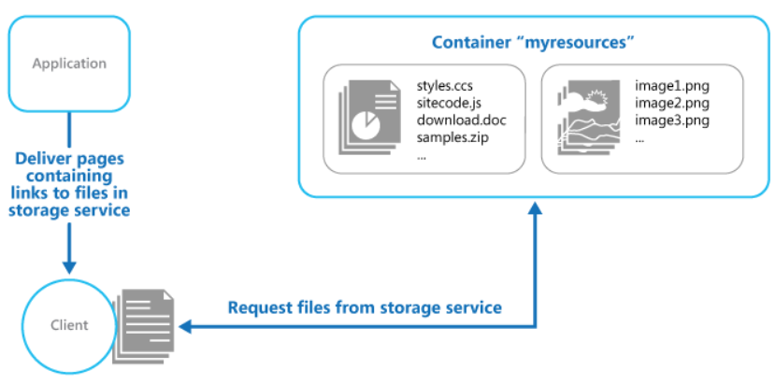
Solution: URL based storage service
Need to take care of –
Security
Read/Write access
Deployment

Slide 61
AWS Solution: Amazon S3 (Simple Storage Service)
Store data objects from 1 byte to 5 TB of data.
Each object has its public / access URL
Highly scalable – allows concurrent read and write access to data by many separate clients or application threads
In same region using S3 with EC2 instance (ie. a VM) is designed to be fast.
Can’t be used in place of file system
Can’t query data
Not suitable for very rapidly changing data
Better solutions available for archiving data
Not suitable for dynamic website hosting

Slide 62
Azure Solution: Blob storage
Blob storage is optimized for storing massive amounts of unstructured data, such as text or binary data
Each blob / object has a public URL
Storage account -> Containers -> Blobs
Three types of blobs – block, append and page
Block blobs store text and binary data, up to about 4.7 TB. Block blobs are made up of blocks of data that can be managed individually.
Append blobs are made up of blocks like block blobs, but are optimized for append operations. Append blobs are ideal for scenarios such as logging data from virtual machines.
Page blobs store random access files up to 8 TB in size. Page blobs store the VHD files that back VMs.
- Same type of constrains like in S3 (no queries, search, file based access etc.)

Slide 63
Scenario: Static Content Via CDN & Archiving
Content Delivery Network (CDN) nodes are use to service static content. Provides additional options like caching, routing optimizations.
AWS CloudFront – a CDN solution that can be used with S3 in the back-end for a CDN based static content delivery solution
Azure CDN – global solution for rapidly delivering high bandwidth content to users.
Archived data should cost less as it is accessed very infrequently.
AWS Glacier – an archiving solution that costs much less than S3.
Azure Blob – has archive tier (in addition to hot & cool tiers)

Slide 64
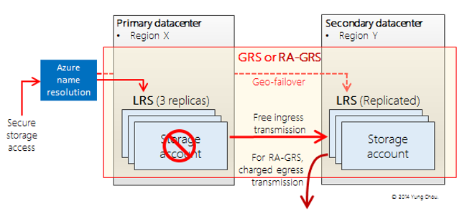
Azure Storage - Redundancy
Locally Redundant Storage (LRS)
Geo-Redundant Storage (GRS)
Read-Access Geo-Redundant Storage (RA-GRS)
Zone-Redundant Storage (ZRS)
Notes:
Locally Redundant Storage (LRS) Azure Storage provides high availability by ensuring that three copies of all data are made synchronously before a write is deemed successful. These copies are stored in a single facility in a single region. The replicas reside in separate fault domains and upgrade domains. This means the data is available even if a storage node holding your data fails or is taken offline to be updated. When you make a request to update storage, Azure sends the request to all three replicas and waits for successful responses for all of them before responding to you. This means that the copies in the primary region are always in sync. LRS is less expensive than GRS, and it also offers higher throughput. If your application stores data that can be easily reconstructed, you may opt for LRS.
Geo-Redundant Storage (GRS) GRS makes three synchronous copies of the data in the primary region for high availability, and then it asynchronously makes three replicas in a paired region for disaster recovery. Each Azure region has a defined paired region within the same geopolitical boundary for GRS. For example, West US is paired with East US. This has a small impact on scalability targets for the storage account. The GRS copies in the paired region are not accessible to you, and GRS is best viewed as disaster recovery for Microsoft rather than for you. In the event of a major failure in the primary region, Microsoft would make the GRS replicas available, but this has never happened to date.
Read-Access Geo-Redundant Storage (RA-GRS) This is GRS plus the ability to read the data in the secondary region, which makes it suitable for partial customer disaster recovery. If there is a problem with the primary region, you can change your application to have read-only access to the paired region. The storage client library supports a fallback mechanism via Microsoft.WindowsAzure.Storage.RetryPolicies.LocationMode to try to read from the secondary copy if the primary copy can’t be reached. This feature is built in for you. Your customers might not be able to perform updates, but at least the data is still available for viewing, reporting, etc. You also can use this if you have an application in which only a few users can write to the data but many people read the data. You can point your application that writes the data to the primary region but have the people only reading the data access the paired region. This is a good way to spread out the performance when accessing a storage account.
Zone-Redundant Storage (ZRS) This option can only be used for block blobs in a standard storage account. It replicates your data across two to three facilities, either within a single region or across two regions. This provides higher durability than LRS, but ZRS accounts do not have metrics or logging capability.

Slide 65
Scenario: Query-able Relational Database (PaaS) in cloud for transactional apps
Transactional scenarios need to use RDBS
RDBM on cloud needs to
dynamically scale
transactional processing
PaaS service, hence no infrastructure management
High availability
Business continuity and Disaster Recovery

Slide 66
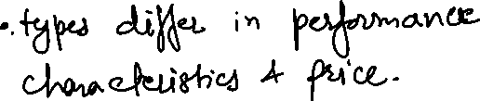

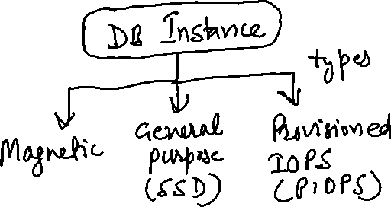
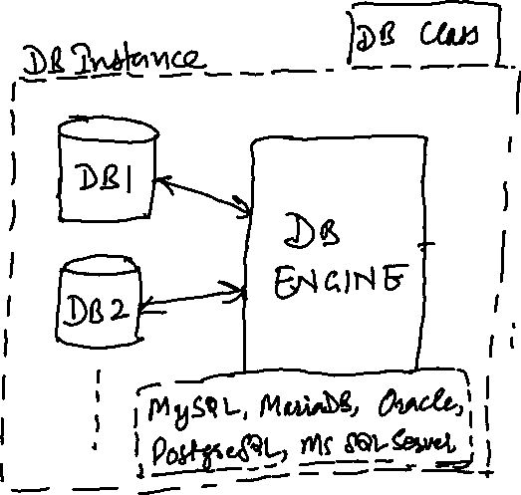

AWS Solution: AWS RDS (Relational Database Services)

Slide 67
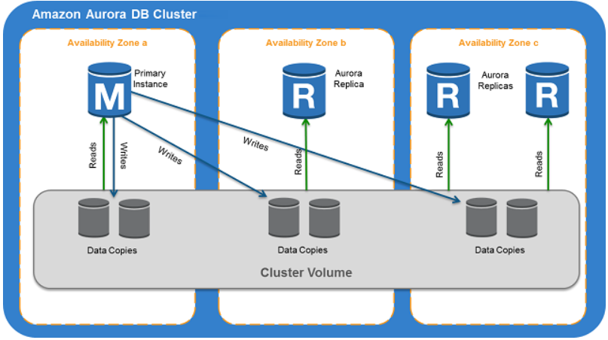
AWS Aurora – PaaS DB Service
Fully managed, MySQL- and PostgreSQL-compatible, relational database engine.
DB cluster defines one or more DB instances + a cluster volume spanning different AZs.
End points – cluster, reader and instance.
Notes:
A cluster endpoint is an endpoint for an Aurora DB cluster that connects to the current primary instance for that DB cluster. Each Aurora DB cluster has a cluster endpoint and one primary instance. The cluster endpoint provides failover support for read/write connections to the DB cluster. Use the cluster endpoint for CRUD operations, including queries.
A reader endpoint is an endpoint for an Aurora DB cluster that connects to one of the available Aurora Replicas for that DB cluster. The reader endpoint provides load balancing support for read-only connections to the DB cluster, not individual queries.
An instance endpoint is an endpoint for a DB instance in an Aurora DB cluster that connects to that specific DB instance. The instance endpoint provides direct control over connections to the DB cluster, e.g. for query level load balancing.

Slide 68
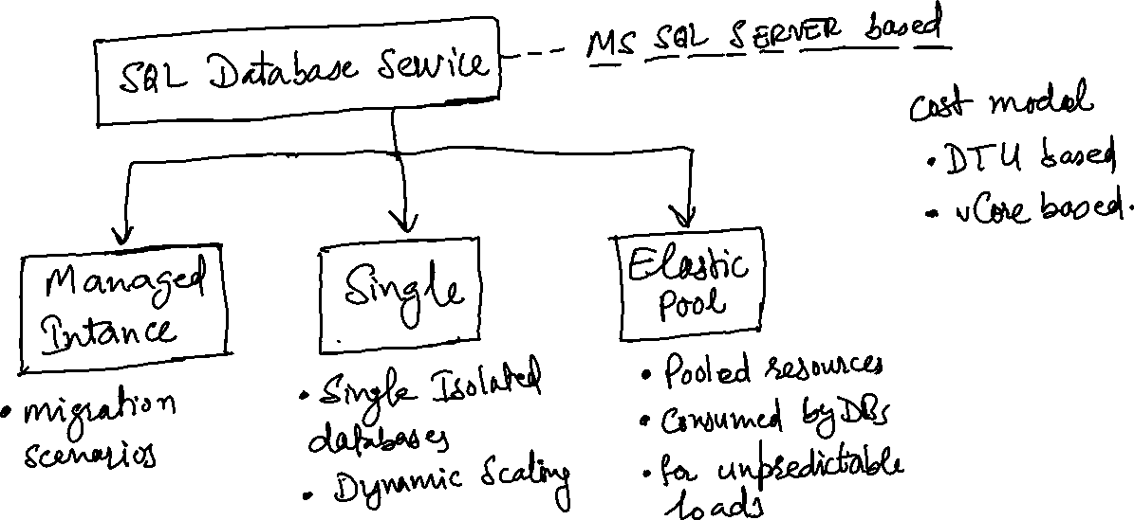
Azure Solution: SQL Database service
Notes:
Single db – its own set of resources managed via a logical server
Elastic pool – a pooled database in an elastic pool with a shared set of resources managed via a logical server
Managed Instance – a collection of databases that contains system and user databases and sharing set of resources
DTU – Database Throughput Unit
Azure also has separate managed services for MySQL and PostgreSQL

Slide 69
Scenario: NoSQL Databases in Cloud
Motivation to use NoSQL DBs
Bigness
NoSQL is key part of new data stack supporting big data – big number of users, big number of computers, big supply chains, big science and so on.
Data stored all around in a distributed manner does not fit well with RDBMS
High Volume
FB needs to store 135 billions messages a month, Twitter has problem of storing 7 TB data per day.
All such data needs to be distributed
Fast Key-Value access
Most NoSQL solutions provide hashing on a key and reading its value directly from the memory.
Flexible Schema and Flexible Data types
NoSQL products support a whole range of new data types
Complex objects can be easily stored without a lot of mapping.
Lack of structure allows much more flexibility
Notes:
http://highscalability.com/blog/2010/12/6/what-the-heck-are-you-actually-using-nosql-for.html

Slide 70
Cost of using NoSQL
Things taken for granted in RDBMS –
Transactional atomic writes
Indexing of non-key columns
Query optimizing
Declarative set oriented queries
– are sacrificed in NoSQL.
NoSQL – Provides AP of the CAP theorem – i.e. Consistency is sacrificed.
SQL – Provides CA of the CAP theorem – Partition tolerance is sacrificed.
Notes:
Partition tolerance, in this context, means the ability of a data processing system to continue processing data even if a network partition causes communication errors between subsystems
CAP is frequently misunderstood as if one has to choose to abandon one of the three guarantees at all times. In fact, the choice is really between consistency and availability only when a network partition or failure happens; at all other times, no trade-off has to be made.

Slide 71
Categories of NoSQL DBs
Key-Value Stores
Data stored in key and value pairs
Document Stores
Stored record is a ‘document’
Wide Column Stores
Semi-schematized and semi-hierarchical
Graph Databases
Explicitly track relationship between entities

Slide 72
Key Value stores
Structure of one record can differ from other in the same collection
This concept is basis of other NoSQL categories as well
Cache like speed and simpler data
most of the data is non-hierarchical – so RDBMS is not required for such data
Data is simple, but storage technology mush be more capable
Repos are distributed
Fault tolerance
Fast
Highly available
Examples
Azure Table Storage
Memcached DB
Voldmort of linked-in

Slide 73
Document Stores
A record is a ‘document’
Each document is a set of Key-Values
JSON Object <-> Document for many NoSQL DBs
Supports Versioning
Documents have URLs, therefore, REST friendly
HTTP orientation of Document Stores –
CouchDB has Show functions that return HTML
HTML is stored in ‘design’ documents
Each show function is accessible via URL
So, entire app could be implemented in a Document DB
Examples
Azure Document DB (Now subsumed in Cosmos DB)
Apache Couch DB
Amazon Dynamo DB
Open Source Mongo DB

Slide 74
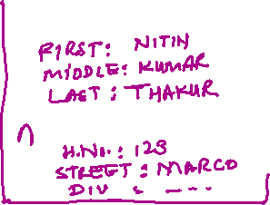
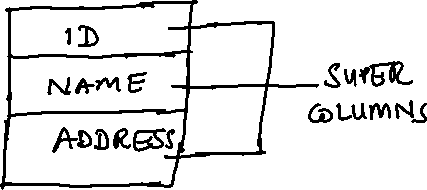
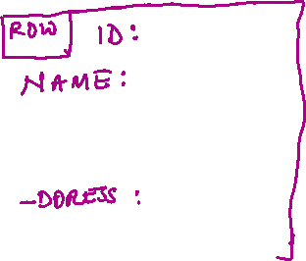
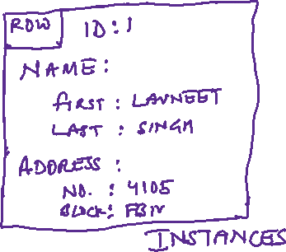
Wide Column Stores
Semi-structured and Semi-hierarchical
Also called Column Family stores
Table Name – Super Column Family
Super Columns
Column 1
Column 2
schema is defined
schema free
Notes:
e.g. Apache Cassandra, HyperTable, Apache Hbase, Google BigTable

Slide 75
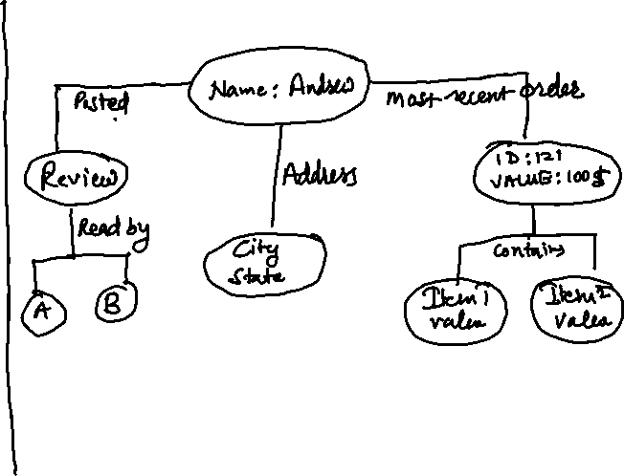
Graph Databases
Explicitly track relationships between entities
e.g. Chris City Auckland
Examples
Allegro Graph
Neo4j
Twitter’s Flock DB
Relation
Node 1
Node 2

Slide 76

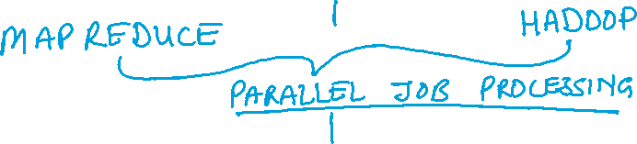
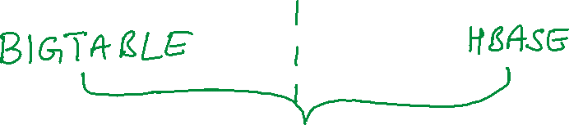
NoSQL – Common Traits
GOOGLE
APACHE / OPEN SOURCE

Slide 77
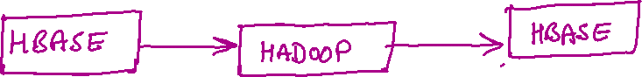


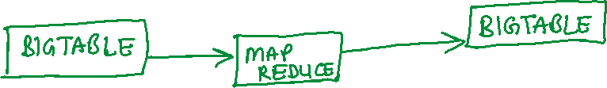



Slide 78
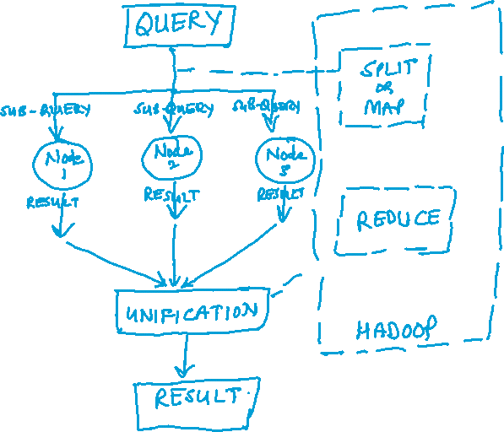
Why Parallel Job Processing Engines?
Querying NoSQL is less straightforward than RDBMS
data is stored in less structured way
data stored is distributed
Queries are therefore broken up and executed across multiple repos on different servers
Sub-query’s results need to be collected and unified

Slide 79
Common Consistency Models
Eventual Consistency
Changes made in one replica will be transmitted to others in asynchronous manner
There is propagation delay which might fetch older data
Eventually, the queries will find the correct data
Optimistic Concurrency
No locking of rows by single user
In low contention of data scenarios
No persistent connection to db server needed
DB servers free to serve large number of users in lesser time
Buffered Writes
Writes in aggregates
Notes:
Pessimistic concurrency involves locking rows at the data source to prevent other users from modifying data in a way that affects the current user
when a user performs an action that causes a lock to be applied, other users cannot perform actions that would conflict with the lock until the lock owner releases it.
primarily used in environments where there is heavy contention for data

Slide 80
Common NoSQL Indexing Models
Most of the NoSQL databases index on keys used for rows / entities / documents and / or partitions
CouchDB indexes Views as well
Allegro Graph indexes everything (Id, Subject, Predicate, Object & groups)
Some NoSQL DBs provide indexing on secondary columns
Cassandra

Slide 81
Common NoSQL upsides / advantages
Light weight, low friction
easy provisioning, deployment
quick availability due to non-schematic characteristics
devs can start coding against NoSQL due to REST / HTTP based API
Minimalistic Tools requirement
Browser UI serves the purpose
Sharding & Replication
Horizontal partitioning & fan-out queries
Geographic content replication
Web developer friendliness
Cross platform / device operation

Slide 82
Azure Table Storage
Azure Table storage is a service that stores structured NoSQL data in the cloud, providing a key/attribute store with a schemaless design
Common uses of Table storage include:
Storing TBs of structured data capable of serving web scale applications
Storing datasets that don't require complex joins, foreign keys, or stored procedures and can be denormalized for fast access
Quickly querying data using a clustered index
Accessing data using the OData protocol and LINQ queries with WCF Data Service .NET Libraries

Slide 83
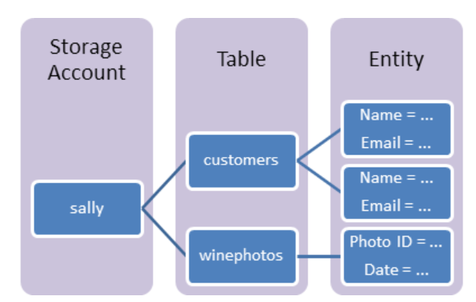
Table: A table is a collection of entities. Tables don't enforce a schema on entities, which means a single table can contain entities that have different sets of properties.
Entity: An entity is a set of properties, similar to a database row. An entity in Azure Storage can be up to 1MB in size. An entity in Azure Cosmos DB can be up to 2MB in size.
Properties: A property is a name-value pair.
Each entity can include up to 252 properties to store data.
Each entity also has three system properties that specify a partition key, a row key, and a timestamp.
Entities with the same partition key can be queried more quickly, and inserted/updated in atomic operations.
An entity's row key is its unique identifier within a partition.

Slide 84
Partition Key Property
Tables are partitioned to support load balancing across storage nodes.
A table's entities are organized by partition. A partition is a consecutive range of entities possessing the same partition key value.
The partition key is a unique identifier for the partition within a given table, specified by the PartitionKey property.
The partition key forms the first part of an entity's primary key. The partition key may be a string value up to 1 KiB in size.
You must include the PartitionKey property in every insert, update, and delete operation.
RowKey Property
The second part of the primary key is the row key, specified by the RowKey property.
The row key is a unique identifier for an entity within a given partition.
Together the PartitionKey and RowKey uniquely identify every entity within a table.
The row key is a string value that may be up to 1 KiB in size.
You must include the RowKey property in every insert, update, and delete operation.
Timestamp Property
The Timestamp property is a DateTime value that is maintained on the server side to record the time an entity was last modified. The Table service uses the Timestamp property internally to provide optimistic concurrency. The value of Timestamp is a monotonically increasing value, meaning that each time the entity is modified, the value of Timestamp increases for that entity. This property should not be set on insert or update operations (the value will be ignored).
Notes:
https://docs.microsoft.com/en-us/rest/api/storageservices/inserting-and-updating-entities
https://docs.microsoft.com/en-us/rest/api/storageservices/querying-tables-and-entities

Slide 85
Exercise
A gift shop wants to start a portal which allows users to view various items present in its store. The items details like name, price, available quantity etc. are shown. Along with that, pictures of item from different angles are also available. There’s a high-res image also available for every item. How will you design a data solution for this?
A company has training period for employees. It has around 500 training modules that an employee needs to cover over the period of 6 months. A module could be a video, document, e-book or other form or content. The requirement is to track the status of modules covered by employee over the training period. How will you design a data base solution to for this.

Slide 86
NoSQL in Azure – Cosmos DB
globally distributed, multi-model database service for mission-critical applications
elastic scaling of throughput and storage worldwide
single digit millisecond latencies at 99th percentile
five well defined consistency models
guaranteed high availability
comprehensive SLAs
automatically indexes all data without requiring schema or indexing management
multi-model service – supports document, key-value, graph and wide column-family data models
Notes:
Single site databases offering Geo-DR capability are a strict subset of globally distributed databases.

Slide 87

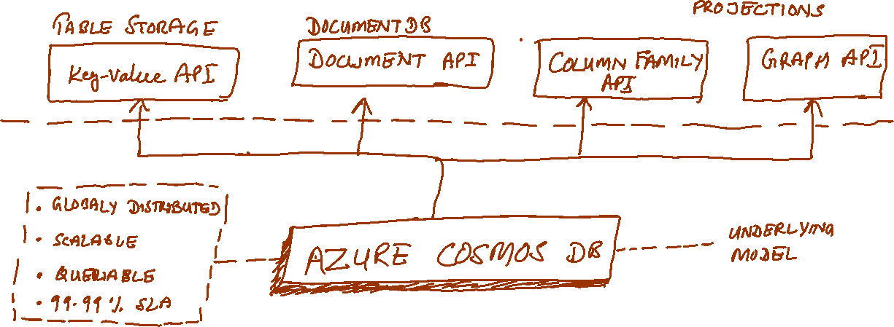

Cosmos DB API

Slide 88
Features of Cosmos DB
Associate unlimited number of regions with Cosmos DB account
Policy based geo-fencing
Failover priorities for regions
Dynamically configurable read and write regions
Geo-local reads and writes
Multi-homing
Well defined consistency models
Notes:
https://docs.microsoft.com/en-us/azure/cosmos-db/distribute-data-globally
To serve a read request, the quorum local to the region in which the read is issued is used. The same applies to writes. A write is acknowledged only after a majority of replicas have durably committed the write locally but without being gated on remote replicas to acknowledge the writes.
Multi-homing interact with a database using either logical (region-agnostic) or physical (region-specific) endpoints.

Slide 89
Consistency Models in Cosmos DB
Strong
Linearizability. Reads are guaranteed to return the most recent version of an item.
Bounded Staleness
Consistent Prefix. Reads lag behind writes by at most k prefixes or t interval
Session
Consistent Prefix. Monotonic reads, monotonic writes, read-your-writes, write-follows-reads
Consistent Prefix
Updates returned are some prefix of all the updates, with no gaps
Eventual
Out of order reads
Notes:
Commercial distributed databases fall into two categories: databases that do not offer well-defined provable consistency choices at all, and databases that offer two extreme programmability choices (strong vs. eventual consistency).
Despite the abundance of research and proposals for more than 50 consistency models, the distributed database community has not been able to commercialize consistency levels beyond strong and eventual consistency.

Slide 90








Strong Consistency
Strong consistency offers a linearizability guarantee with the reads guaranteed to return the most recent version of an item.
Strong consistency guarantees that a write is only visible after it is committed durably by the majority quorum of replicas. A write is either synchronously committed durably by both the primary and the quorum of secondaries, or it is aborted. A read is always acknowledged by the majority read quorum, a client can never see an uncommitted or partial write and is always guaranteed to read the latest acknowledged write.
Azure Cosmos DB accounts that are configured to use strong consistency cannot associate more than one Azure region with their Azure Cosmos DB account.
The cost of a read operation (in terms of request units consumed) with strong consistency is higher than session and eventual, but the same as bounded staleness.

Slide 91
Bounded staleness Consistency
Bounded staleness consistency guarantees that the reads may lag behind writes by at most K versions or prefixes of an item or t time-interval.
Therefore, when choosing bounded staleness, the "staleness" can be configured in two ways: number of versions K of the item by which the reads lag behind the writes, and the time interval t
Bounded staleness offers total global order except within the "staleness window." The monotonic read guarantees exist within a region both inside and outside the "staleness window."
Bounded staleness provides a stronger consistency guarantee than session, consistent-prefix, or eventual consistency. For globally distributed applications, use bounded staleness for scenarios where you would like to have strong consistency but also want 99.99% availability and low latency.
Azure Cosmos DB accounts that are configured with bounded staleness consistency can associate any number of Azure regions with their Azure Cosmos DB account.
The cost of a read operation (in terms of RUs consumed) with bounded staleness is higher than session and eventual consistency, but the same as strong consistency.

Slide 92
Session Consistency
Unlike the global consistency models offered by strong and bounded staleness consistency levels, session consistency is scoped to a client session.
Session consistency is ideal for all scenarios where a device or user session is involved since it guarantees monotonic reads, monotonic writes, and read your own writes (RYW) guarantees.
Session consistency provides predictable consistency for a session, and maximum read throughput while offering the lowest latency writes and reads.
Azure Cosmos DB accounts that are configured with session consistency can associate any number of Azure regions with their Azure Cosmos DB account.
The cost of a read operation (in terms of RUs consumed) with session consistency level is less than strong and bounded staleness, but more than eventual consistency.

Slide 93
Consistent Prefix Consistency
Consistent prefix guarantees that in absence of any further writes, the replicas within the group eventually converge.
Consistent prefix guarantees that reads never see out of order writes. If writes were performed in the order A, B, C, then a client sees either A, A,B, or A,B,C, but never out of order like A,C or B,A,C.
Azure Cosmos DB accounts that are configured with consistent prefix consistency can associate any number of Azure regions with their Azure Cosmos DB account.

Slide 94
Eventual Consistency
Eventual consistency guarantees that in absence of any further writes, the replicas within the group eventually converge.
Eventual consistency is the weakest form of consistency where a client may get the values that are older than the ones it had seen before.
Eventual consistency provides the weakest read consistency but offers the lowest latency for both reads and writes.
Azure Cosmos DB accounts that are configured with eventual consistency can associate any number of Azure regions with their Azure Cosmos DB account.
The cost of a read operation (in terms of RUs consumed) with the eventual consistency level is the lowest of all the Azure Cosmos DB consistency levels.

Slide 95
A technical overview of Azure Cosmos DB
The core type system of Azure Cosmos DB’s database engine is atom-record-sequence (ARS) based
Atoms consist of a small set of primitive types e.g. string, bool, number etc.
Records are structs
Sequences are arrays consisting of atoms, records or sequences
The database engine of Azure Cosmos DB
is capable of efficiently translating and projecting the data models onto the ARS based data model
The core data model is natively accessible from dynamically typed programming languages and can be exposed as-is using JSON or other similar representations.

Slide 96







Resource Model and API Projections
Notes:
https://azure.microsoft.com/en-us/blog/a-technical-overview-of-azure-cosmos-db/
The overall resource model of an application using Azure Cosmos DB is a hierarchical overlay of the resources rooted under the database account, and can be navigated using hyperlinks.
With the exception of the item resource - which is used to represent arbitrary user defined content, all other resources have a system-defined schema.
The content model of the item resource is based on atom-record-sequence (ARS) described earlier.
Both, container and item resources are further projected as reified resource types for a specific type of API interface
Each resource is uniquely identified by a stable and logical URI and represented as a JSON document.

Slide 97

The overall resource model of an application using Azure Cosmos DB is a hierarchical overlay of the resources rooted under the database account, and can be navigated using hyperlinks.
With the exception of the item resource - which is used to represent arbitrary user defined content, all other resources have a system-defined schema.
The content model of the item resource is based on atom-record-sequence (ARS) described earlier.
Both, container and item resources are further projected as reified resource types for a specific type of API interface

Slide 98

Horizontal Partitioning
All the data within an Azure Cosmos DB container (e.g. collection, table, graph etc.) is horizontally partitioned and transparently managed by resource partitions
Notes:
A resource partition is a consistent and highly available container of data partitioned by a customer specified partition-key
it provides a single system image for a set of resources it manages and is a fundamental unit of scalability and distribution
Customers can elastically scale throughput of a container by programmatically provisioning throughput at a second or minute granularity on an Azure Cosmos DB container.

Slide 99

Global distribution
a customer’s resources are distributed along two dimensions: within a given region, all resources are horizontally partitioned using resource partitions (local distribution).
Each resource partition is also replicated across geographical regions (global distribution).
Currency
RUs (Request Units)
RUs/sec or RUs/minute

Slide 100

AWS NoSQL - DynamoDB
DynamoDB organizes data into tables consisting of items.
Each item in a DynamoDB table can define an arbitrary set of attributes, but all items in the table must define a primary key that uniquely identifies the item.
This key must contain an attribute known as the “hash key” and optionally an attribute called the “range key.”
Notes:
https://d0.awsstatic.com/whitepapers/migration-best-practices-rdbms-to-dynamodb.pdf
Often, it is useful to be able to fetch items using a different set of values than the hash and the range keys. DynamoDB supports these operations through local and global secondary indexes. A local secondary index uses the same hash key as defined on the table, but a different attribute as the range key.
A global secondary index can use any scalar attribute as the hash or range key
Reads on global secondary indexes are always eventually consistent, whereas local secondary indexes support eventual or strong consistency.

Slide 101
Cloud App Services (PaaS)

Slide 102
Azure – App Service
PaaS service for hosting web applications, REST APIs and mobile back-ends
Web Apps adds cloud features to application, such as security, load balancing, autoscaling, and automated management.
Take advantage of its DevOps capabilities, such as continuous deployment from VSTS, GitHub, Docker Hub, and other sources, package management, staging environments, custom domain, and SSL certificates.
With App Service, pay for the Azure compute resources you use. The compute resources you use is determined by the App Service plan that you run your Web Apps on

Slide 103

App Service Plan
In App Service, an app runs in an App Service plan.
An App Service plan defines a set of compute resources for a web app to run
One or more apps can be configured to run on the same computing resources (or in the same App Service plan).
Notes:
When you create an App Service plan in a certain region (for example, West Europe), a set of compute resources is created for that plan in that region. Whatever apps you put into this App Service plan run on these compute resources as defined by your App Service plan.

Slide 104

Each App Service plan defines
Region (West US, East US, etc.)
Number of VM instances
Size of VM instances (Small, Medium, Large)
Pricing tier (Free, Shared, Basic, Standard, Premium, Premium V2, Isolated, Consumption)

Slide 105



Running the app
In the Free and Shared tiers, an app receives CPU minutes on a shared VM instance and cannot scale out.

Slide 106


Scaling the app
the App Service plan is the scale unit of the App Service apps
If the plan is configured to run five VM instances, then all apps in the plan run on all five instances
If the plan is configured for autoscaling, then all apps in the plan are scaled out together based on the autoscale settings

Slide 107
Cloud Messaging Services
Notes:
https://www.youtube.com/watch?v=SG0tn4pUvy8&t=140s

Slide 108
Messaging Services
Used for machine – machine and/or service – service communication
Provides decoupling between producers of messages and consumers of messages
Data streaming, ingestion and retention scenarios
Connectivity between on-premise and cloud scenarios
Key glue that enables loosely coupled and distributed cloud based solutions

Slide 109
Where messaging services are used?
Financial Services
Utilities & Telecom
Logistics
Insurance
Healthcare
Government
Customer Information Systems
Billing integration
Smart meter & grid
Command & control
Medical Records
Care quality metrics
Patient monitoring & diagnostics
Order processing
eCommerce
Delivery Notifications
Inventory Management
Routing
Enrolment
Claims processing
Risk Modelling
Regulatory filing
Inter-bank transfers
Order fulfilment & trading
Settlement
Reconciliation
Pricing and Quote Updates

Slide 110

Azure Messaging Services

Slide 111
Azure Service Bus
Messaging as a service
Queues and Topics
Reliable asynchronous communication
Rich features for temporal control
Routing and filtering
Convoys & Sessions (related message with state)

Slide 112

Where does Service bus fit in?
Decoupling and providing durability are primary drivers for using service bus

Slide 113

Features of Service Bus

Slide 114

Topics & Subscriptions
Sender knows only about Topic
Receivers know only about Subscription
Filters and Actions exist on Subscription
Notes:
version based gradual upgrade scenario using topics: create filters based on version of message. When new version of system is ready add its subscription to topic and let it handle v2 messages. v1 messages can continue to go to v1 subscription for as long as one wants.

Slide 115
Azure Event Hubs
Distributed Data Streaming solution
Event Hubs
A streaming service designed to do a low latency distributed stream ingress (i.e. going-in)
A partitioned consumer scale model
A time retention buffer
An elastic component in the middle of your telemetry / IoT / big data chain

Slide 116


Slide 117
Event Hub features
Archive
Proximity (related data is grouped together)
Order
Consistent Playback
Tremendous scale

Slide 118

Event Hubs conceptual architecture

Slide 119
Relays & Hybrid Connections
Securely connect to on-premises data and services from anywhere
Load balance multiple sites behind a single endpoint
Protect internal services by projecting a cloud endpoint
Does not require any network changes
Live request-response and streaming services
Hybrid cloud + on premises

Slide 120
Cloud Architectures

Slide 121
N-Tier
Traditional layered
Higher layer calls lower ones, not vice-versa
Web-Queue-Worker
Purely PaaS
Microservices
Many small independent services
Event-driven Architecture
Can be a liability – not easy to update individual components
Suitable for app migration
Generally IaaS
Web FE + Worker BE
FE <-> BE communication through async msg Q
Suitable for simple domains
Services are loosely coupled
Communicate through API contracts
Uses pub-sub model
Pubs & Subs are independent
Suitable for apps that ingest large volume of data
Suitable when subsystems need to perform different actions on same data
Big Data Big Compute
Specialized architecture that fit certain profiles
Divides large datasets into chunks, parallel process and analysis

Slide 122
N-tier Architecture Style
An N-tier architecture divides an application into logical layers and physical tiers.
Layers are a way to separate responsibilities and manage dependencies.
Tiers are physically separated, running on separate machines.

Slide 123
When to use this architecture
Typically implemented as infrastructure-as-service (IaaS) applications, with each tier running on a separate set of VMs.
Consider an N-tier architecture for:
Simple web applications.
Migrating an on-premises application to Azure with minimal refactoring.
Unified development of on-premises and cloud applications.
Best practices
Use autoscaling to handle changes in load. See Autoscaling best practices.
Use asynchronous messaging to decouple tiers.
Cache semi static data. See Caching best practices.
Configure the database tier for high availability, using a solution such as SQL Server Always On availability groups.
Place a web application firewall (WAF) between the front end and the Internet.
Place each tier in its own subnet, and use subnets as a security boundary.
Restrict access to the data tier, by allowing requests only from the middle tier(s).

Slide 124
N-tier architecture on Virtual Machines

Slide 125
Each tier consists of two or more VMs, placed in an availability set or virtual machine scale set.
Multiple VMs provide resiliency in case one VM fails.
Load balancers are used to distribute requests across the VMs in a tier.
A tier can be scaled horizontally by adding more VMs to the pool.
Each tier is also placed inside its own subnet, meaning their internal IP addresses fall within the same address range.
That makes it easy to apply network security group rules and route tables to individual tiers.
The web and business tiers are stateless. Any VM can handle any request for that tier. The data tier should consist of a replicated database.
Network security groups restrict access to each tier. For example, the database tier only allows access from the business tier.

Slide 126
Role of Application Gateway
Web traffic load balancer enables us to manage traffic to our web applications
Operates at application level (OSI level 7 - Application).
Traditional load balancers operate at transport layer (OSI level 4 – TCP & UDP) and route traffic based on IP address and port.
Application Gateway can route traffic based on URL
SSL termination
supports terminate encryption at gateway, so data travels un-encrypted to the backend servers. Saves overhead.
Web application firewall – protection against common exploits
Multiple site hosting, Redirection, Session affinity etc.

Slide 127
N-tier architecture – Multi-region deployment

Slide 128
Role of Traffic Manager in Multi-region deployment
Traffic Manager allows users to control traffic distribution across various application endpoints.
The Traffic Manager distributes the traffic using the configured routing method
Priority, Weighted, Performance, Geographic
Constant monitoring of the endpoint health.
Automatic failover in case the endpoints fail.
Functions at the DNS level. It uses the DNS to route clients to precise service endpoints, according to the traffic-routing rules and methods.
Traffic Manager operation modes:
Active | Passive – hot failover
Active | Passive – cold failover
Active | Active – load balanced

Slide 129
Web-Queue-Worker architecture

Slide 130
The core components of this architecture are
a web front end that serves client requests,
a worker that performs resource-intensive tasks, long-running workflows, or batch jobs.
a message queue - the web front end communicates with the worker through it.
Other components that are commonly incorporated into this architecture include:
One or more databases.
A cache to store values from the database for quick reads.
CDN to serve static content
Remote services, such as email or SMS service. Often these are provided by third parties.
Identity provider for authentication.

Slide 131
The web and worker are both stateless.
Session state can be stored in a distributed cache.
Any long-running work is done asynchronously by the worker.
The worker can be triggered by messages on the queue or run on a schedule for batch processing.
The worker is an optional component. If there are no long-running operations, the worker can be omitted.
The front end might consist of a web API.
On the client side, the web API can be consumed by a single-page application that makes AJAX calls, or by a native client application.

Slide 132
Web-Queue-Worker on Azure

Slide 133
Consider this architecture style for:
Applications with a relatively simple domain.
Applications with some long-running workflows or batch operations.
When you want to use managed services, rather than infrastructure as a service (IaaS).

Slide 134
Microservices Architecture
a microservices architecture is an approach to building a server application as a set of small services
Each service runs in its own process and communicates with other processes using protocols such as HTTP/HTTPS, WebSockets, or AMQP
Each microservice implements a specific end-to-end domain or business capability within a certain context boundary, and each must be developed autonomously and be deployable independently
each microservice should own its related domain data model and domain logic (sovereignty and decentralized data management) and could be based on different data storage technologies (SQL, NoSQL) and different programming languages

Slide 135
Why a microservices architecture?
it provides long-term agility. Microservices enable better maintainability in complex, large, and highly-scalable systems by letting you create applications based on many independently deployable services that each have granular and autonomous lifecycles.
As an additional benefit, microservices can scale out independently
Instead of having a single monolithic application that you must scale out as a unit, you can instead scale out specific microservices
That way, you can scale just the functional area that needs more processing power or network bandwidth to support demand, rather than scaling out other areas of the application that don't need to be scaled. That means cost savings because you need less hardware

Slide 136


Slide 137
Architecting fine-grained microservices-based applications enables continuous integration and continuous delivery practices.
It also accelerates delivery of new functions into the application. Fine-grained composition of applications also allows you to run and test microservices in isolation, and to evolve them autonomously while maintaining clear contracts between them.
As long as you don't change the interfaces or contracts, you can change the internal implementation of any microservice or add new functionality without breaking other microservices.

Slide 138

Data sovereignty per microservice
An important rule for microservices architecture is that each microservice must own its domain data and logic.

Slide 139
Challenges and solutions for distributed data management
Challenge #1
How to define the boundaries of each microservice
Challenge #2
How to create queries that retrieve data from several microservices
Challenge #3
How to achieve consistency across multiple microservices
Challenge #4
How to design communication across microservice boundaries

Slide 140
Challenge #1: How to define the boundaries of each microservice
focus on the application's logical domain models and related data
Try to identify decoupled islands of data and different contexts within the same application
The terms and entities that are used in those different contexts might sound similar, but you might discover that in a particular context, a business concept with one is used for a different purpose in another context, and might even have a different name
user: guest vs customer vs buyer
always attempt to minimize the coupling between those microservices

Slide 141
Challenge #2: How to create queries that retrieve data from several microservices
how to implement queries that retrieve data from several microservices, while avoiding chatty communication to the microservices from remote client apps
need a way to aggregate information if you want to improve the efficiency in the communications of your system
Notes:
An example could be a single screen from a mobile app that needs to show user information that's owned by the basket, catalog, and user identity microservices. Another example would be a complex report involving many tables located in multiple microservices.

Slide 142
API Gateway
In a microservices architecture, the client apps usually need to consume functionality from more than one microservice.
the client needs to handle multiple calls to microservice endpoints
Coupling: Without the API Gateway pattern, the client apps are coupled to the internal microservices. The client apps need to know how the multiple areas of the application are decomposed in microservices. When evolving and refactoring the internal microservices, those actions impact maintenance because they cause breaking changes to the client apps due to the direct reference to the internal microservices from the client apps. Client apps need to be updated frequently, making the solution harder to evolve.
Too many round trips: A single page/screen in the client app might require several calls to multiple services. That can result in multiple network round trips between the client and the server, adding significant latency. Aggregation handled in an intermediate level could improve the performance and user experience for the client app.
Security issues: Without a gateway, all the microservices must be exposed to the "external world", making the attack surface larger than if you hide internal microservices that aren't directly used by the client apps. The smaller the attack surface is, the more secure your application can be.
Cross-cutting concerns: Each publicly published microservice must handle concerns such as authorization and SSL. In many situations, those concerns could be handled in a single tier so the internal microservices are simplified.

Slide 143

API Gateway Pattern
Notes:
Similar to Façade Design Pattern. Also known as the "backend for frontend" (BFF) because you build it while thinking about the needs of the client app

Slide 144
the API gateway sits between the client apps and the microservices.
It acts as a reverse proxy, routing requests from clients to services.
It can also provide additional cross-cutting features such as authentication, SSL termination, and cache.

Slide 145
CQRS with query/reads tables
Another solution for aggregating data from multiple microservices is the Materialized View pattern.
In this approach, you generate, in advance (prepare denormalized data before the actual queries happen), a read-only table with the data that's owned by multiple microservices.
The table has a format suited to the client app's needs. —you create a denormalized table in a different database that's used just for queries.
it also improves performance considerably when compared with a complex join, because you already have the data that the application needs in the query table. Of course, using Command and Query Responsibility Segregation (CQRS)

Slide 146
"Cold data" in central databases
For complex reports and queries that might not require real-time data, a common approach is to export your "hot data" (transactional data from the microservices) as "cold data" into large databases that are used only for reporting.
That central database system can be a Big Data-based system, like Hadoop, a data warehouse like one based on Azure SQL Data Warehouse, or even a single SQL database that's used just for reports (if size won't be an issue).
Notes:
https://docs.microsoft.com/en-us/dotnet/architecture/microservices/architect-microservice-container-applications/distributed-data-management

Slide 147

Challenge #3: How to achieve consistency across multiple microservices
how to implement end-to-end business processes while keeping consistency across multiple microservices.
Eg Price update for a product in Catalog Service

Slide 148
To make an update to the Basket microservice, the Catalog microservice should use eventual consistency probably based on asynchronous communication such as integration events (message and event-based communication).
Most microservice-based scenarios demand availability and high scalability as opposed to strong consistency.
Mission-critical applications must remain up and running, and developers can work around strong consistency by using techniques for working with weak or eventual consistency.
This is the approach taken by most microservice-based architectures.

Slide 149
Challenge #4: How to design communication across microservice boundaries
Communicating across microservice boundaries is a real challenge.
In this context, communication doesn't refer to what protocol you should use (HTTP and REST, AMQP, messaging, and so on). Instead, it addresses what communication style you should use, and especially how coupled your microservices should be.
Depending on the level of coupling, when failure occurs, the impact of that failure on your system will vary significantly.

Slide 150
An HTTP-based approach is perfectly acceptable; the issue here is related to how you use it.
If you create long chains of synchronous HTTP calls across microservices, communicating across their boundaries as if the microservices were objects in a monolithic application, your application will eventually run into problems.
It's recommended that you use only asynchronous interaction for inter-microservice communication, either by using asynchronous message- and event-based communication, or by using (asynchronous) HTTP polling independently of the original HTTP request/response cycle.
(See details here)
Notes:
In a distributed system like a microservices-based application, with so many artifacts moving around and with distributed services across many servers or hosts, components will eventually fail. Partial failure and even larger outages will occur, so you need to design your microservices and the communication across them considering the common risks in this type of distributed system.

